Slide 1
Setting Expectations
Communication & DS Ticket Support
MS Team
Establishing Team Norms

Slide 2

Communication
Don’t be afraid to ask questions. Some of the projects focus on complicated topics and the teams are learning together. There are no bad questions in this type of environment!

Slide 3

Communication
Be willing to “speak up” if problems arise. Your Corporate Partner TA and The Data Mine staff are here to support you, but you have to communicate with us when you need help. Please do not wait until the end of the semester to bring issues to our attention or say you don’t understand a concept. The earlier that you let us know, the easier we can help you.

Slide 4

Communication
It is not ok to stop participating if the content gets difficult. Even if other students are more experienced, everyone should 1) make an effort to learn and get caught up and 2) find some way to contribute while trying to build up the necessary technical skills. Your Corporate Partner Mentor and TA can provide suggestions of other resources to help learn content. Again, you have to “speak up” when you need help!

Slide 5
DS Support Ticket
Are you stuck and need data science support?
Send a DS support ticket to datamine-help@purdue.edu
Be sure to answer these following questions when submitting a ticket.
Could you please describe the issue that you are facing?
What’s the absolute path to your code?
What troubleshooting steps have you tried so far?
Is there a minimum reproducible example that you could provide?
For more information visit https://the-examples-book.com/crp/students/ds_team_support

Slide 6


MS Team
All team members are required to have MS Teams installed on their computers. The Data Mine uses MS Teams as one of our primary communication tools.
Be sure to check MS Team daily for team updates.
Respond to TA and messages sent by mentors in chat or using emotes in teams.
Share team progress in teams chat so everyone on the team is on the same page.
Message mentors via team if you have any questions regarding the project throughout the sprint.

Slide 7
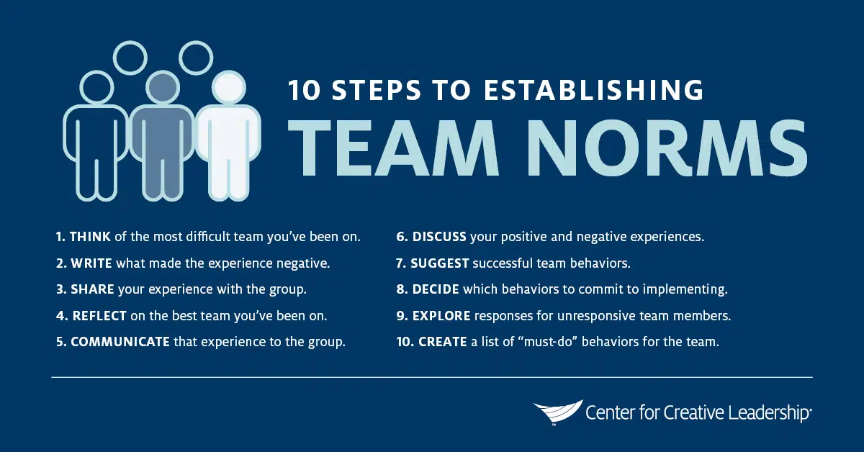
Basic Rules of Engagement
https://www.ccl.org/articles/leading-effectively-articles/the-real-world-guide-to-team-norms/

Slide 8
Establishing Team Norms
What are some must do behaviors we will commit to?
Example: Ask before giving feedback. Sometimes team members might be going through a tough time and hearing negative feedback would not be appropriate.

